Slide 1
Database Normalization
Amir Dirin 2023

Slide 2
What do you think about the following table?
Student_ID | Name | Subject | HoD | Office No.
1 | Timo | ICT, BIT | Simo | 0934945
2 | Satu | BIT | Simo | 0934945
3 | Mika | UX | Simo | 0934945
4 | Outi | ICT | Simo | 0934945
This table is not very efficient with storage
This design does not protect data integrity
Third, this table does not scale well.

Slide 3
Exercise
Student_ID | Name | Subject | HoD | Office No.
1 | Timo | ICT, BIT | Simo | 0934945
2 | Satu | BIT | Simo | 0934945
3 | Mika | UX | Simo | 0934945
4 | Outi | ICT | Simo | 0934945
Three major problem with this table
Insertion anomaly
Deletion anomaly
Updating anomaly

Slide 4
Insertion anommaly
Student_ID | Name | Subject | HoD | Office No.
1 | Timo | ICT, BIT | Simo | 0934945
2 | Satu | BIT | Simo | 0934945
3 | Mika | UX | Simo | 0934945
4 | Outi | ICT | Simo | 0934945
5 | Matti | ICT | Simo | 0934945
Imagine if we would have added 100 more students, we must insert redundant data for every row.

Slide 5
Delete anomally
Student_ID | Name | Subject | HoD | Office No.
1 | Timo | ICT | Simo | 0934945
2 | Satu | ICT | Simo | 0934945
3 | Mika | ICT | Simo | 0934945
4 | Outi | ICT | Simo | 0934945
Here we not only remove the student we also remove the details about the subject information, hod, office no.

Slide 6
Update Modification anomaly
Student_ID | Name | Subject | HoD | Office No.
4 | Timo | ICT, BIT | Simo Vesa | 0934945
2 | Satu | BIT | Simo Vesa | 0934945
1 | Mika | UX | Simo Vesa | 0934945
3 | Outi | ICT | Simo Vesa | 0934945
In case we need to change one field we have to update the entire table.

Slide 7
Normalization
Convert the table to comply with the relational database rule

Slide 8
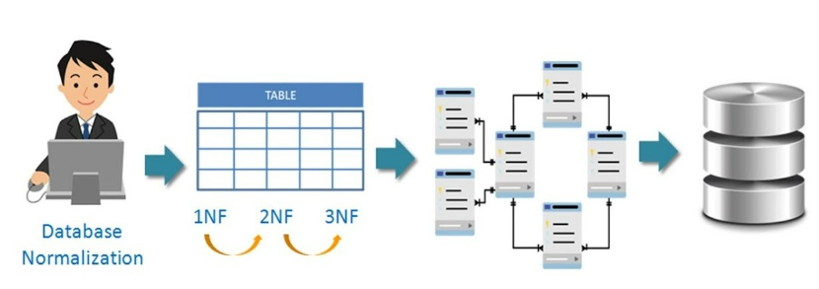
Database Normalization Process
https://www.analyticsvidhya.com/blog/2022/08/database-normalization-a-step-by-step-guide-with-examples/

Slide 9
Normalization
Database normalization is the process of removing redundant data from your tables to improve
Storage efficiency,
Data integrity, and
Scalability.
In the relational model, a method exists for quantifying how efficient a database is. These classifications are called normal forms (or NF), and there are algorithms for converting a given database between them.
Normalization generally involves
Splitting existing tables into multiple ones, which must be re-joined or linked each time a query is issued.

Slide 10
First Normal Form (1st NF)
There are two violations of the first normal form:
The subject field contains more than one piece of information with more than one value in a single field, it would be very difficult to search for all books on a given subject
Student_ID | Name | Subject | HoD | Office No.
1 | Timo | ICT, BIT | Simo | 0934945
2 | Satu | BIT | Simo | 0934945
3 | Mika | UX | Simo | 0934945
4 | Outi | ICT | Simo | 0934945

Slide 11
Question
In our table the subject information is common for all students.
How we can solve this problem?
The subject-related field can be separated from the student’s name table.

Slide 12
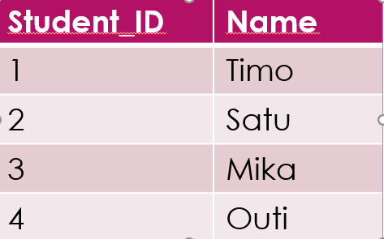
Solution
Student_ID | Name | Subject | HoD | Office No.
1 | Timo | ICT, BIT | Simo | 0934945
2 | Satu | ICT | Simo | 0934945
3 | Mika | UX | Simo | 0934945
4 | Outi | ICT | Simo | 0934945
Divide the table into two tables
Subject | HoD | Office No.
ICT | Simo | 0934945
BIT | Simo | 0934945
UX | Simo | 0934945
ICT | Simo | 0934945

Slide 13
1st NF
Student_ID | Name | Subject
1 | Timo | ICT
2 | Satu | BIT
3 | Mika | UX
4 | Outi | ICT
Subject | HoD | Office No.
ICT | Simo | 0934945
BIT | Simo | 0934945
UX | Simo | 0934945
5 | Timo | BIT
Normalization is about minimizing data redundancy.
Here only the subject has been repeated, any changes into a subject table impact all student.
In this solution, we do not have problems such as
Insert, delete, update.

Slide 14
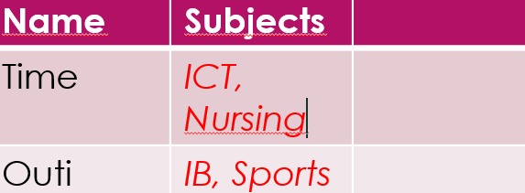
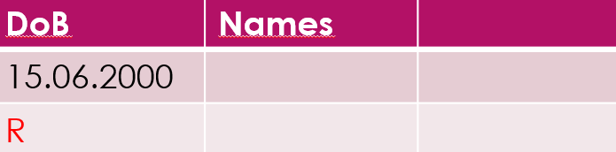

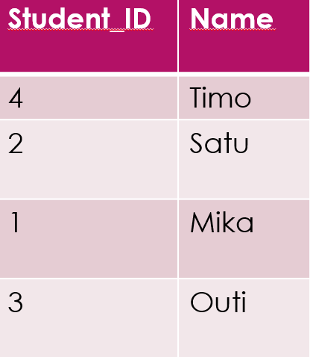
Normalization techniques.
Normalization process:
Scalable table design which can be easily extended
If the table is not even the first data normal forms then that is not a good database design
1N rule
Each column should contain atomic values
In each column the value must be the same kind
Each column must have a unique name
Order in which data is saved does not matter

Slide 15
Exercise
Is this a first N table based on the rules defined in the previous slides?
Student_ID | Name | Subject
4 | Timo | OS, DB
2 | Satu | Java
1 | Mika | C,C++
3 | Outi | ICT
No! rule number1 is broken since the subject column does not contain an atomic value
How to solve the problem?

Slide 16
Make the subject values atomic
Student_ID | Name | Subject
4 | Timo | OS
2 | Satu | Java
1 | Mika | C
3 | Outi | ICT
Does this a 1N table?
Check the rule!
5 | Timo | DB
6 | Mika | C++

Slide 17
2nd NF
For the table to be in second normal form it must satisfy two conditions
It should be in 1st Normal form
Should not be partial dependency in the table
Dependency VS. Partial-dependency
Dependency: In the example with student-ID we are able to get all the relevant data from the table, e.g.,
Give the major for student 2.
Means that all fields dependent to the student-ID
Student Table
pk
student_ID | Name | Reg-no | Major | Address
1 | Timo | CSE-18 | CSE | TN
2 | Timo | IT-18 | IT | AP
3 | Matti | CSE-18 | CSE | HR
4 | Satu | CSE-18 | CSE | MH
5

Slide 18
Partial Dependency
Subject Table
What about partial-dependency?
Score Table
subject_ID | subject_Name
teacher
score_ID | student-ID | subject-ID | marks | teacher
1 | 1 | 1 | 82 | Amir
2 | 1 | 2 | 77 | Simo
3 | 2 | 1 | 85 | Vesa
4 | 3 | 3 | 82 | Auvo
Can we get the score of the student’s number 1?
Student_ID | Name | Reg-no | Major | address
No, Why? Since it will be difficult to know which students number 1 we are referring to? Therefore we need student-ID and subject_ID together to make it unique for identifying the data. Here teachers are not dependent on the students so it is partially dependent on the subject. In second N partial-dependency should not exist

Slide 19
So we have to remove the teacher’s name from the score table because it is partially dependent we can do this in many different ways
1. move the teachers’ names to the Subject table
2. Add a new table for teachers and use the teacher-ID wherever we want

Slide 20
3rdNF
In the score table the exam name and total marks are missing
TotalMarks depends to the ExamName, e.g., KMM vs. Math, which total marks does not depend on primary keys
sore_ID | student-ID | subject-ID | marks | teacher
1 | 1 | 1 | 82 | Amir
2 | 1 | 2 | 77 | Simo
3 | 2 | 1 | 85 | Vesa
4 | 3 | 3 | 82 | Auvo
ExamName | TotalMarks
For a table to be in 3rd Normal form:
It has to be in 2nd Normal Form
And it should be transitive dependency

Slide 21
Transitive dependency
Score_ID | Student_ID | Subject_ID | Marks | ExamName | TotalMarks
The primary key for the score table is a composite key (students_ID and subject_ID).
The ExamName now depends on students_ID and subject_ID. For example, for some courses (Java) we have a practical exam and for some, e.g., Math we do not. So we can not say that the exam name depends on the student’s name and subject both.
What about the TotalMarks? Does it depend on the student or subject? TotalMarks depends on the exam name. For example, the exam names define how the points are calculated for the total marks? E.g., 40 points for assignment and 50 points for exam in KMM course. But for Math written exam gives the total marks.
So in the table, the TotalMarks and ExamName are related this is called transitive dependency. The solution is that the ExamName and TotalMarks must be in the new table.

Slide 22
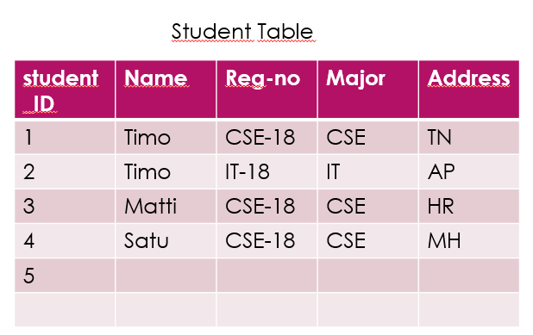
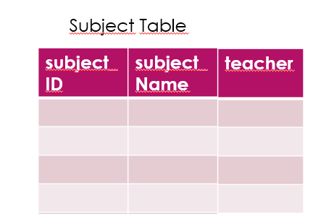
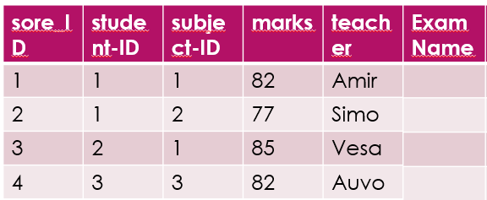

Solution for transitive dependency
Score Table
Exam Table

Slide 23
Boyce-Codd Normal Form (3.5N)
The table should be in 2N form
For any dependency A—>B then A should be a super key
Or A not be a prime attribute while B is a prime attribute; meaning a none. prime attribute drives the prime attribute which BCNF does not allow this type of dependency
One student may participate in multiple courses which has a different teacher. Multiple teachers teach one subject, e.g., java
Here we can use the teacher’s name to find the subject as well. The subject is a primary key.
Student_ID | Subject | teacher
101 | Java | Amir
101 | C++ | Simo
102 | Java | Vesa
103 | C# | Hannu
Who teaches java course?

Slide 24
Solution BCNF
Student Table
Student_ID | Teacher_ID
Teacher Table
Teacher_ID | Teacher | subject

Slide 25
4N
It should satisfy BCNF
IT should not have
Multi-Valued dependency
In 2NF we removed partial dependency and,
In 3NF we removed transitive dependency.
In 4NF Multi-valued dependency
A—>B, is a multi-valued dependency if A1 depends on B1 and B2.
A | B
A | B | C
X
OK
A table should have at least 3 columns to have a multi-valued dependency
B and C should be independent from each other

Slide 26
Example
Student_ID | Course | hobby
1 | Physic | Aikido
1 | Math | Ski
2 | C# | football
Student_ID | Course
Student_ID | hobby
There is no relation between course and hobby of students so it is advised it should be in a separate table of the multi-value dependency.
Student and hobby table

Slide 27
5N(PJNF)-Project Join Normal Form
It should be in 4NF
It should not have Join Dependency
If so then we can make it to a small relation
Supplier | Product | customer
Supplier | product
Supplied | Product | customer
ABC | X1 | Giganti
ABC | Y2 | Ikea
DFCH | M25 | metropolia
Supplier | customer
Customer | product
define
customer
Supplier
Product

Slide 28
In this table solution some data are missed for example selling the X1 by ABC to Giganti. The 5N says if you lose the joint to the data then you should not decompose the data.

Slide 29
Exercise
staffNo | doctorName | patientNo | patientName | appointmet date time | surgeryNo
S101 | Timo O | P100 | Amir D | 12.08 10:00 | S10
S102 | Outi K | P106 | Marko H | 23.08 14:00 | S15
S103 | Robin D | P200 | Amir D | 14.09 16:00 | S30
S104 | Magnus H | P201 | Marko H | 15.10 12:00 | S13
Make sure the table is normalized
Notes:
https://www.studocu.com/ph/document/silliman-university/accounting-information-system/normalization-practice-exercises-answers/25049152

Slide 30
This not normalized since in the appointment column there are multiple values that violate the 1NF.
Considering the staff and pationetNo as candidate keys there are many anomalies that exist.
Insertion anomalies:
To insert a new patient to make an appointment with doctor we need to enter the correct detail for the staff, e.g., to add a new patient we need to add patientNo, patientName and am an appointment, we must enter the corrrect details of the doctor (staffNo, doctorName) so the detail consistent with values for the designated doctor.
Deletion anomalies:
If we want to delete a patient named Amir D for example, two records need to be deleted. This anomaly is also obvious when we want to delete the doctor, multiple recodes needs to be deleted to maintain the data integrity. When we delete a doctor recod for exam Magnus H about his patients are also lost from the database
Modification anolamalies
With redundant data, when we change the value of one column of a doctor, doctorName we must update all the Doctor records that assign to a particula patient otherwise the data would inconsistent. We also need to to modify the appointmet schedules because differe Doctor has different schedules.

Slide 31
Let’s assume that a patient is registered at only one surgery and he or she has more than one appointment on a given day. All the schedules have been fixed for the whole days and week.
In 1NF
We remove all the repeating group’s appointment and assign new column( appDate and appTime) and assigned primary keys (candidate keys) Then think about functional dependency

Slide 32
FD1
staffNo | apptDate | appTime | doctorName | patientNo | patientName | surgeryNo
FD2
FD3
FD4
FD5

Slide 33
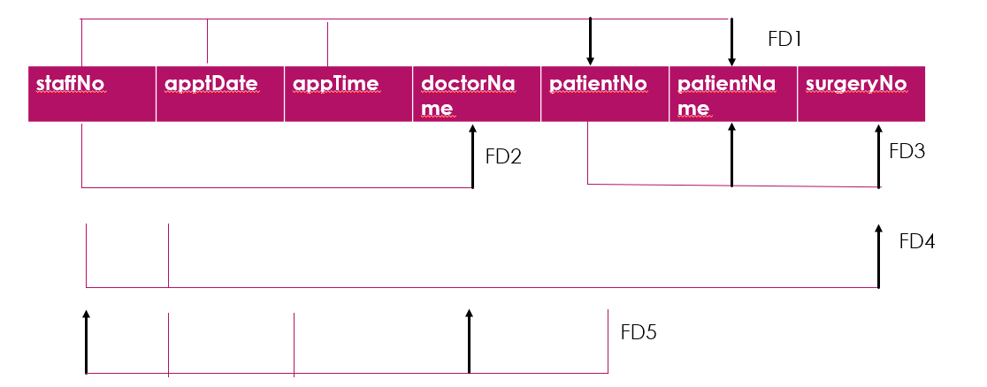
FD1 is already 2NF which depends

Slide 34
staffNo | doctorName
Doctor (staffNo,doctorName)
FK
staffNo | appDate | surgeryNo
Surgery (staffNo, appDate, surgeryNo)
patientNo | patientName
Patient (patientNo, patientName)
FK
Appointment (staffNo,appDate, appTime, patientNo)
staffNo | appDate | appTime | patientNo

Slide 35
Exercise 2
Customer Name | Item | ShippingAddress | NewsLetter | supplier | supplierPhone | price
Mikko | xBox | Ahventie, Vaasa | XboxNews | Microsoft | 0800112 | 250
Outi | PlayStation | Oikotie, TRE | xboxNews,PlayStation | tukku | 080012 | 300
Timo | PSP, xBOX | Ahventie, Vaasa | Play Station | sony | 080012 | 450

Slide 36
2NF
CustomerID | customerName | ShippingAddress | NewsLetter
ItemID | Supplier | SupplierPhone | Price
PK
PK
CustomerID | ItemID

Slide 37
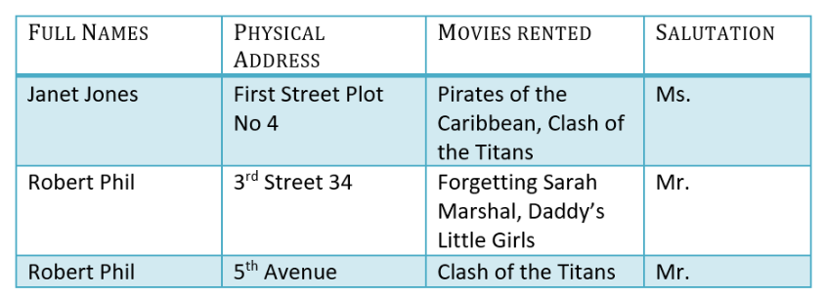
Normalization Example (18.01.2023)
https://www.youtube.com/watch?v=J-drts33N8g
https://www.guru99.com/database-normalization.html

Slide 38
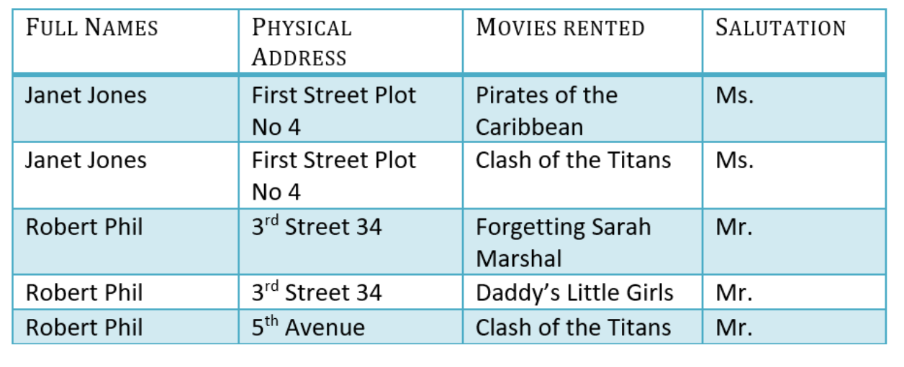
Example
1st NF
Each table cell should contain a single value.
Each record needs to be unique.
https://www.guru99.com/database-normalization.html

Slide 39
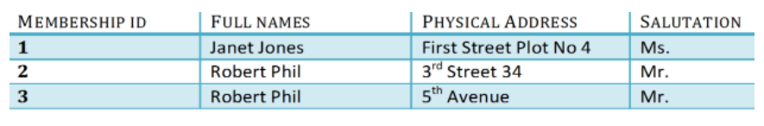
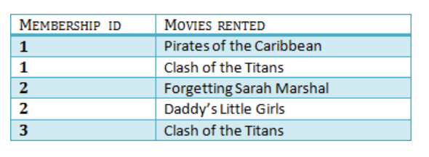
2 NF
2nd NF
Rule 1- Be in 1NF
Rule 2- Single Column Primary Key that does not functionally dependent on any subset of candidate key relation

Slide 40
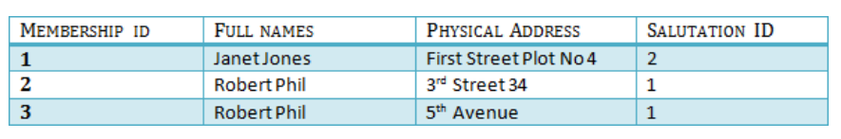
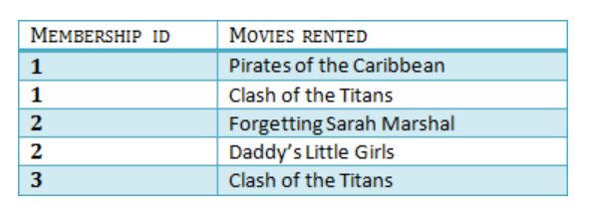
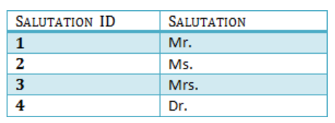
3 NF
3rd NF
Rule 1- Be in 2NF
Rule 2- Has no transitive functional dependencies

Slide 41
Review of the last week solution
Project Visio
Status of the Nektio
Design your project’s Database

